Slide 1

Traffic light Signal with Button
Sprint 2

Slide 2
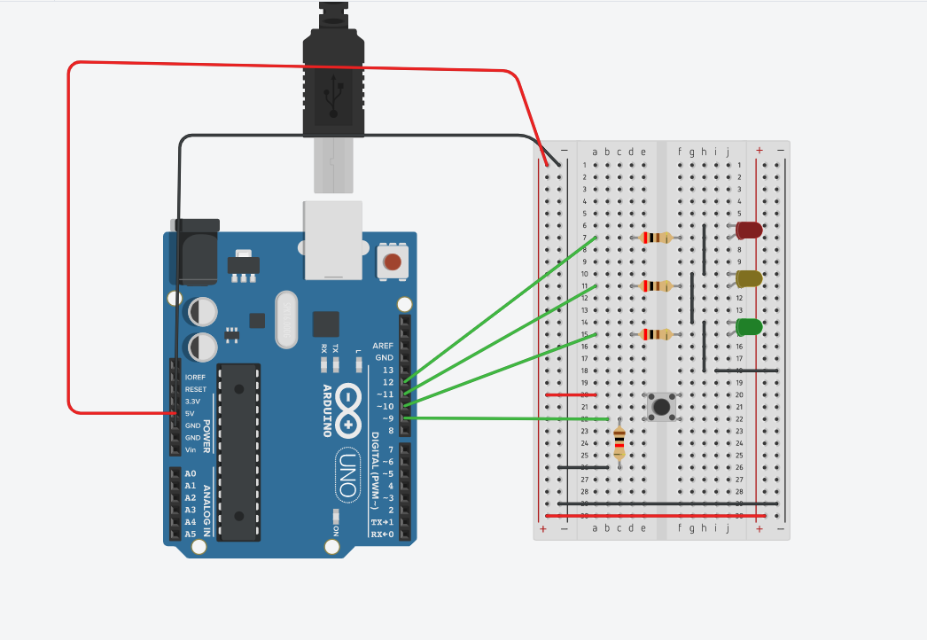
Circuit Diagram

Slide 3
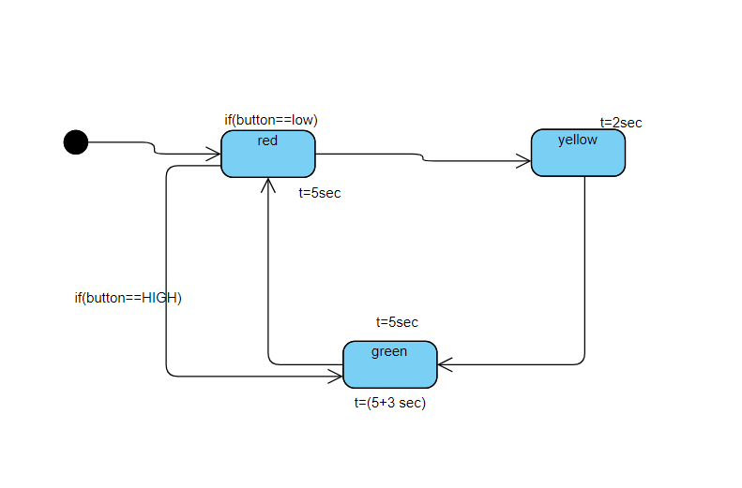
State Machine Diagram

